Slide 1
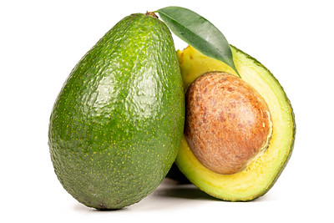
Persea americana:
The berry with one seed
Presentation by: Stephanie Marie Rosario
Notes:
Photo by Marco Verch on Flickr

Slide 2
.
Previous Education:
My First BA was in Politics & Creative Writing
and a minor in Hebrew. I went to Brandeis University in MA.
My Background
.
Second BA was Communication Sciences & Disorders. I went to Queens College in NY.
.
I work currently in a tourist attraction in NYC.
.
I am a Poet. I love learning languages.
I love traveling abroad. I feel fulfilled when I get to do missionary work.

Slide 3
1.
Introduction & Origin of data
2.
Methods & Manipulation of data
CONTENTS
5.
3.
Exploring data
4.
Analysis of data
5.
Summary & Conclusion

Slide 4
Project Introduction/ Background
This project is about the avocado production in 3 different states.
The avocado dataset was taken from Kaggle.
The 3 cities I chose were: Boston, Chicago, and South Carolina

Slide 5
Three questions being answered:
1. Is there a significant difference between the consumption of avocados between the 3 different cities?
2. Is there a significant difference between the average prices of avocados between the 3 different cities?
3. Is there any significant difference between the type of avocado (conventional or organic) and the region?

Slide 6
Methods (1)
Methods (2)
Received data from Github and downloaded it.
Used Python language to get some answers!

Slide 7
Data Wrangling Overview
I deleted a column
Isolated the 3 cities I wanted to use each time and
I recoded type and region columns to a number value

Slide 8
Exploring Data:
Summary Statistics:
Rows
Important Variable
Time
18,249
Region - 54
From 2015 - 2018
Columns
Sample Size of Each
Originally 13
338 Each except one Region

Slide 9
Analysis of Data (1)
IV - Region, DV - Total Volume

Slide 10
When looking at if there was a significant difference between Total Volume and Region:
There WAS a significant difference between the 3 regions by Total Volume.
What was found??
Chicago consumes the most Avocados and it consumes more than 2 times what South Carolina consumes.
Boston consumes 1/4 less than what Chicago consumes.

Slide 11
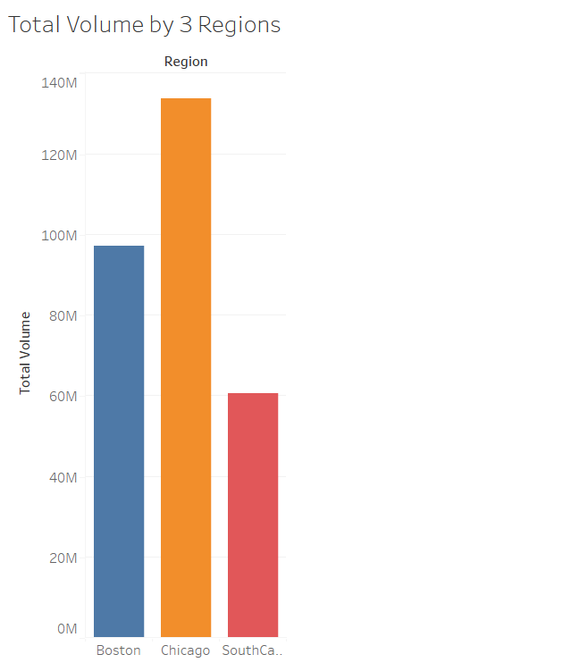
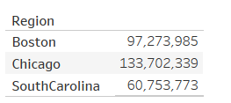

Slide 12
Analysis of Data (2)
IV - Region, DV - Average Price

Slide 13
When looking at if there was a significant difference between Average Price and Region:
There was a significant difference between two of the city comparisons and one not significant.
Between Boston and South Carolina and Chicago and South Carolina there was a significant difference.
Between Boston and Chicago there was not a significant difference in the Average Price.
There is a .15 cent difference between Chicago and South Carolina and a .13 cent difference between Boston and South Carolina. But the difference between Boston and Chicago is about .02-.03 cents - Not Significant.

Slide 14
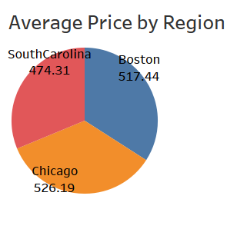
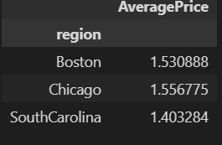

Slide 15
Analysis of Data (3)
IV - Region, DV - type

Slide 16
When looking to see if there was a significant difference between the types of avocados (conventional or organic) and each of the 3 regions it was:
The facts:
Each region was receving the same amount of conventional and organic.
There was no-- “this region has more organic than this other region.”
NOT Significant at all!!

Slide 17
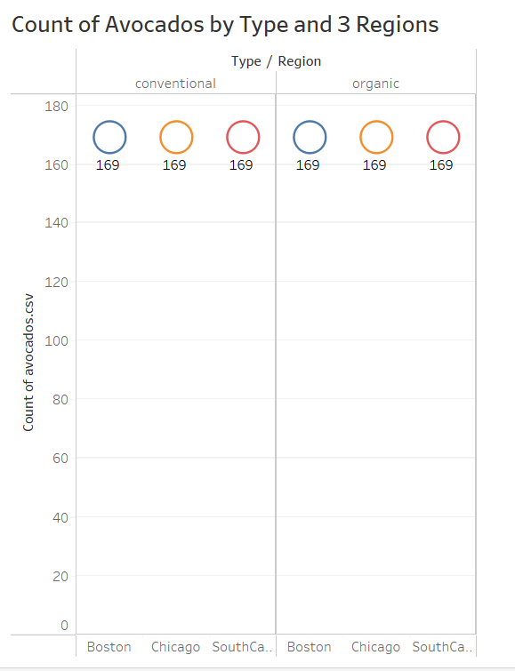

Slide 18
Summary
There is a significant difference between the 3 regions (Boston, Chicago, and South Carolina when it comes to Total Volume.
There is a significant difference between two sets of regions when it comes to Average Price (Between Boston and South Carolina & Chicago and South Carolina).
There is no significant difference between Boston and Chicago when it comes to Average Price (It was minimal).
There is no significant difference between Type of Avocado(Conventional and Organic) and Region. They all had the same number of each type for each of the 3 regions.

Slide 19
Conclusions
This data can be used to see where production really goes in each region. For example supply and demand. If for certain one region is having a bigger volume of avocados, then more resources need to be distributed there.
If for example I could figure out which region recevies the most organic avocados or if certain regions have that more in demand then maybe farmers and companies do not have to cultivate as much conventional avocados because the demand is higher for organic.
It’s important to see these kinds of things it affects national companies and the every day person.

Slide 20
Thoughts/Questions For Myself
1.
2.
I think I should have looked at Total Volume in terms of Conventional and Organic in each of the 3 regions.
That was the difference I had been looking for!
Exploring more would have been fun. For example in Tableau I saw that the Average Price for organic avocados in the 3 regions was generally higher than conventional.

Slide 21
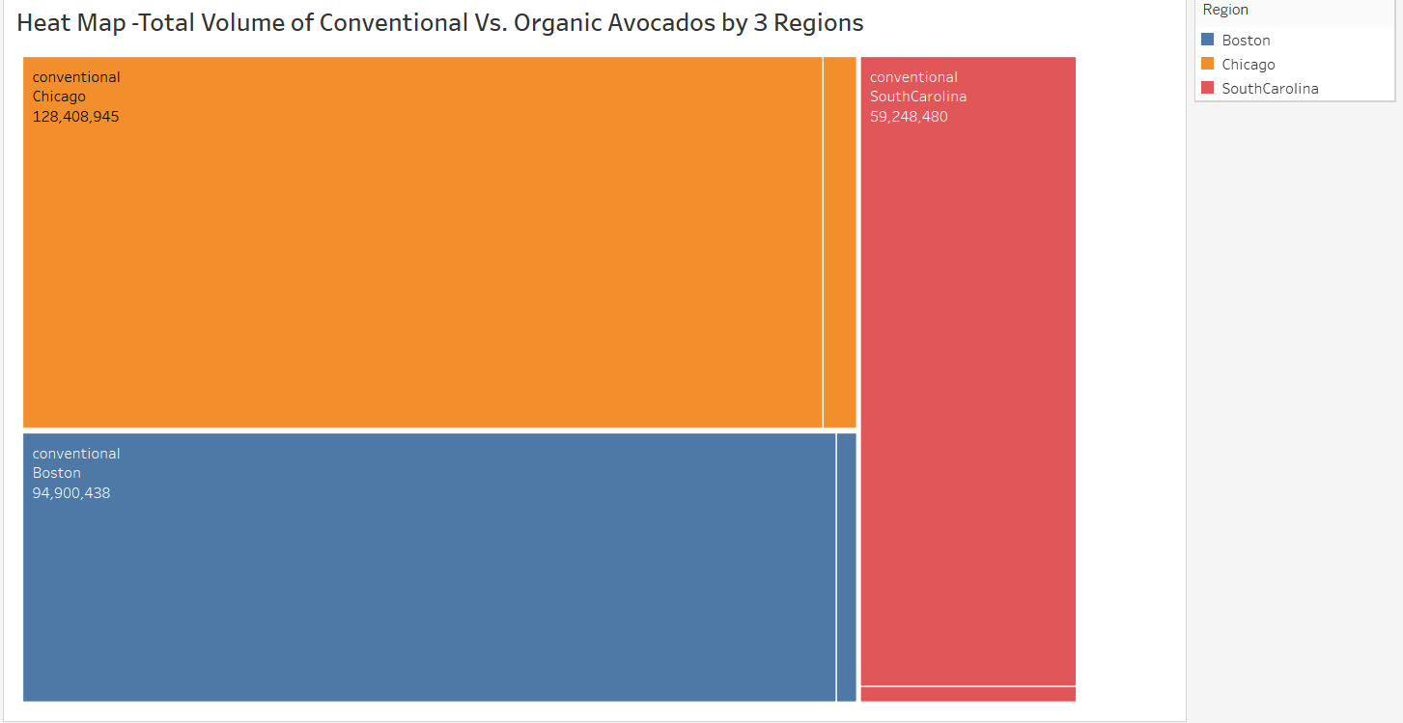



Tree Map

Slide 22
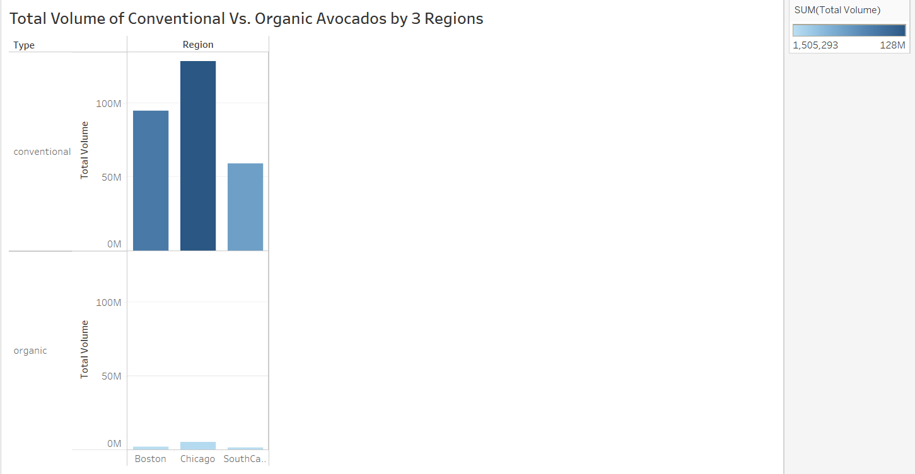

Slide 23
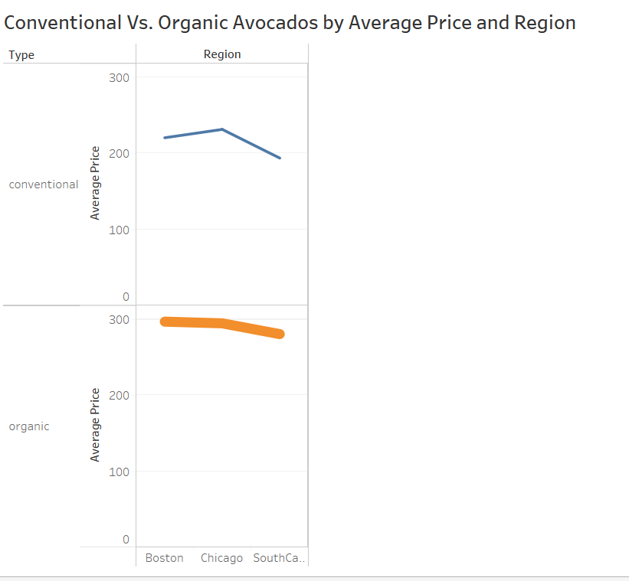

Slide 24
Questions?
Questions?
Questions?

Slide 25
Sources
Kaggle
Flikr
Entity

Slide 26
THANK YOU

